Slide 1

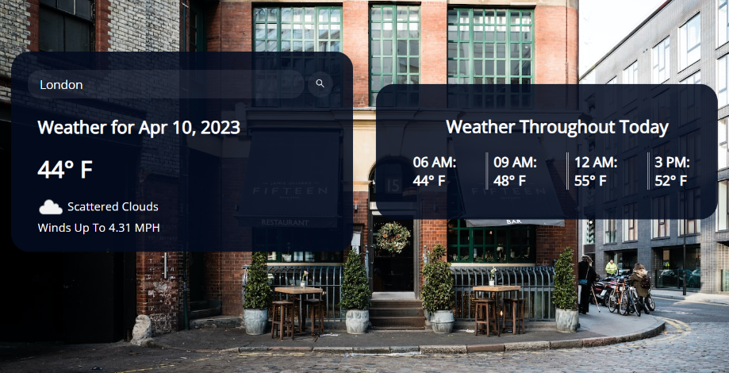
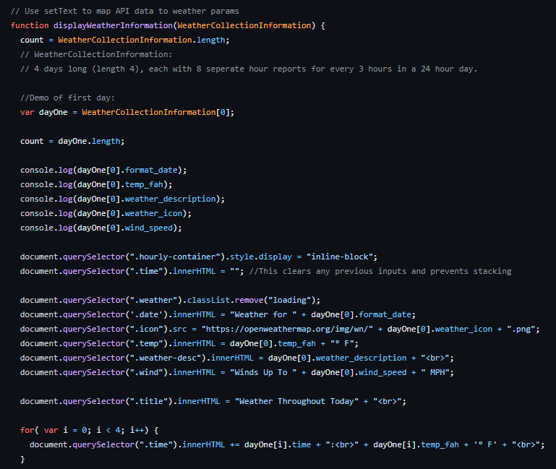
TEAM MEMBERS: Cortland Diehm, Steven Werden, Nikki Theresa Diguard, Ash Dewald, Renee Edison
Introduction/Scope of the Project
As part of the final project, the Weather Warriors developed a website where the user will be able to see the weather for any given city. The current weather will display and then a daily forecast will appear. This page will give people a way to explore the weather around the world and is intended to be used for anyone interested in the weather. The interface is simple and user friendly.
Design
Conclusions
After several group meetings and collaborations, a working webpage that meets all of our requirements was developed. The Weather Warriors worked well together and created a web application that was both efficient and aesthetically pleasing. A short demonstration will be included in the video that will accompany this project. The video describes our collaboration and website functions.
Recommendations or Future Work
Provide an opportunity for a user to “email” or “text” results to a given email address or phone number
Give the user the ability to set a default city.
Create a mobile application that people can download.
A real-time map that displays other weather conditions like incoming storms for a certain city.
Detect the current city when opening the website.
Technology
The tools that we utilized for this project are GitHub Repository, Google Docs, Microsoft Teams, Discord, and Adobe Express.
The system technology includes a website. JavaScript was used to contain and interpret the API. HTML was used to frame the webpage and a CSS file linked in the HTML was written to alter the style of the webpage. OpenWeather API was used to get real-time weather data for every city on the planet, which was passed to the program in JSON format.
Requirements
Needs the ability to link data to the webpage
A user must be able to enter a city name
The page must return the results of the current weather for the city requested
System must allow for multiple searches; one after another.
Results must include current temperature and current weather conditions.
References
OpenWeatherAPI -https://openweathermap.org/api

